Slide 1


Maali Alkhaldi
23 Feb 2025

Slide 2
Outline
Executive Summary
Introduction
Methodology
Results
Conclusion
Appendix

Slide 3

Executive Summary
Summary of methodologies
Data Collection: Used SpaceX API and web scraping to gather Falcon 9 launch data.
Data Wrangling: Cleaned the data, handled null values, and transformed categorical features into numerical ones using One-Hot Encoding.
Exploratory Data Analysis (EDA): Identified relationships between launch success and features such as payload mass, orbit type, and launch site.
Predictive Analysis: Built machine learning models (Logistic Regression, Decision Trees, etc.) to predict landing success.
Interactive Visualizations: Created interactive maps and dashboards for deeper insights.
Summary of Results:
Achieved high prediction accuracy with the best model.
Insights showed that payload mass and launch site significantly influence landing success.
Interactive dashboards helped in understanding key factors, such as launch success by site and payload range.

Slide 4
Introduction
Project background and context
SpaceX Falcon 9’s reusability offers significant cost savings by landing the first stage of the rocket after launch. Predicting whether the Falcon 9 first-stage will land successfully is vital for cost estimation and launch efficiency.
Problems you want to find answers
What factors influence the successful landing of Falcon 9's first stage?
How can machine learning models predict landing success?
What role do attributes like payload mass, orbit type, and launch site play in landing success?

Slide 5

Section 1

Slide 6
Methodology
Executive Summary
Data collection methodology:
Data was collected using the SpaceX API and web scraping Falcon 9 launch records from Wikipedia.
Perform data wrangling
Cleaned the data by normalizing JSON from the API and handling missing values, such as replacing null payload mass with mean values.
Perform exploratory data analysis (EDA) using visualization and SQL
Perform interactive visual analytics using Folium and Plotly Dash
Perform predictive analysis using classification models
How to build, tune, evaluate classification models

Slide 7
Data Collection
API Collection:
Used the SpaceX REST API (https://api.spacexdata.com/v4/launches/past) to gather historical launch data.
Sent a GET request and normalized the JSON response to a Pandas DataFrame.
Web Scraping:
Scraped Falcon 9 and Falcon Heavy launch records from the Wikipedia page using BeautifulSoup.
Parsed the HTML tables and converted them into a DataFrame for further analysis.

Slide 8
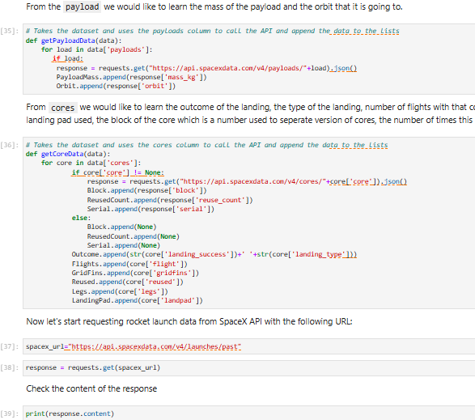
Data Collection – SpaceX API
In the API collection lab, the SpaceX API was used to gather past launch data by making a GET request to the endpoint api.spacexdata.com/v4/launches/past. The data was returned as a JSON object, which was then normalized using the json_normalize function to create a flat table.
The dataset was cleaned and transformed, with additional data collected using specific API endpoints (e.g., capsules, cores) to fill in missing details such as rocket IDs and landing specifications. This data was then preprocessed for further analysis.
Place your flowchart of SpaceX API calls here

Slide 9
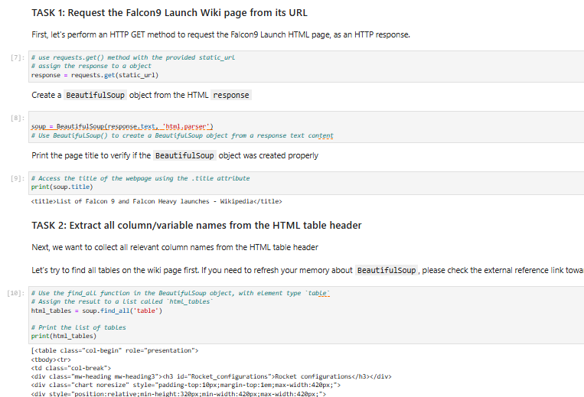
Data Collection - Scraping
In the web scraping lab, Falcon 9 launch data was collected by extracting tables from the Wikipedia page "List of Falcon 9 and Falcon Heavy launches." Using Python's BeautifulSoup package, the relevant HTML tables were scraped, parsed, and converted into a Pandas dataframe for further analysis.
This data was then cleaned and processed to include only the relevant Falcon 9 launch records, preparing it for visualization and predictive modeling in later stages of the project.
Place your flowchart of web scraping here

Slide 10

Data Wrangling
In the data wrangling phase, raw data from both API and web scraping was cleaned and formatted to prepare it for analysis. This involved handling missing or null values, filtering out irrelevant records (e.g., removing Falcon 1 launches), and converting categorical variables into numeric representations using one-hot encoding. The dataset was further refined by extracting and normalizing additional information such as payload mass, rocket IDs, and launch success outcomes, ensuring it was structured and ready for predictive modeling and visualization.

Slide 11
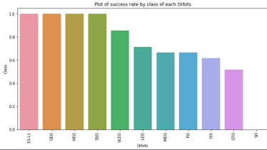
EDA with Data Visualization
During the EDA, various visualizations were created to explore relationships within the dataset. These included:
Bar charts to visualize the success rates of different launch sites and orbit types.
Scatter plots to examine the correlation between payload mass and orbit type.
Line charts to analyze launch success trends over time.
Pie charts to visualize the proportion of successful and unsuccessful launches per site.

Slide 12
EDA with SQL
SQL queries I performed during the EDA:
Count of launches per site: Identified how many launches occurred at each site.
Occurrences of each orbit type: Calculated the distribution of different orbit types across launches.
Success rate by orbit type: Analyzed the success rate of launches grouped by orbit type.
Landing outcomes grouped by site: Aggregated landing outcomes (successful or unsuccessful) for each launch site.
These queries helped identify trends and patterns that were crucial for feature engineering and predictive analysis.

Slide 13
Build an Interactive Map with Folium
In the Folium map, I added several objects to visualize launch sites and outcomes:
Markers: To represent each launch site’s geographic location.
Circles: Indicating the proximity areas around each launch site for visualizing distance effects.
Lines: Showing the trajectory paths between launch sites and landing zones, emphasizing rocket paths.
Popup labels: Displaying additional details like the success/failure of launches at each site.

Slide 14
Build a Dashboard with Plotly Dash
I added the following plots and interactions:
Pie Chart: To visualize launch success and failure rates based on the selected site.
Scatter Plot: To analyze the relationship between payload mass and success/failure.
Dropdown: To allow users to select a launch site and dynamically update the charts.
Range Slider: For selecting payload mass ranges and updating the scatter plot accordingly.

Slide 15
Predictive Analysis (Classification)
Loaded the data using numpy and pandas.
Preprocessed the data, including splitting it into training and testing sets.
Built and fine-tuned machine learning models using GridSearchCV for hyperparameter optimization.
Evaluated models using accuracy as the metric.
Improved the model with feature engineering and algorithm tuning.
Identified the best-performing classification model based on accuracy and performance.

Slide 16
Results
Exploratory data analysis results
Interactive analytics demo in screenshots
Predictive analysis results

Slide 17

Section 2

Slide 18
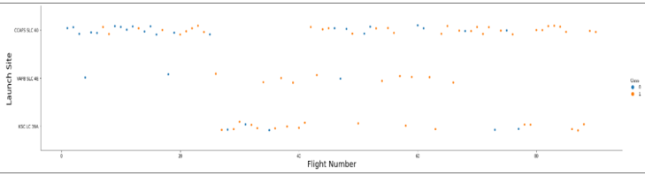
Flight Number vs. Launch Site
Show the screenshot of the scatter plo with explanations

Slide 19
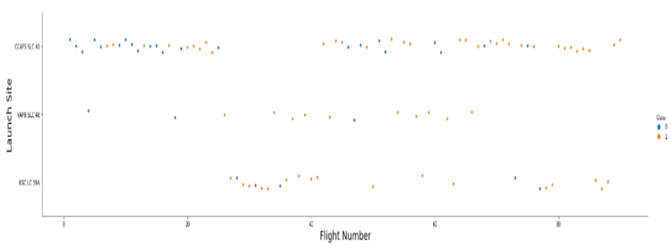
Payload vs. Launch Site
The grater the payload the higher the launch site will success

Slide 20
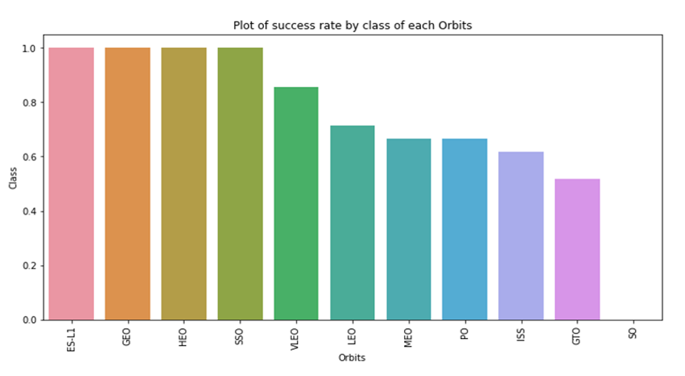
Success Rate vs. Orbit Type
Show a bar chart for the success rate of each orbit type
Show the screenshot of the scatter plot with explanations

Slide 21
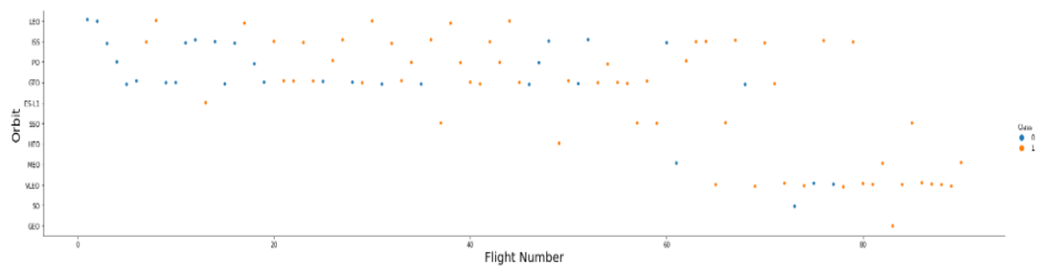
Flight Number vs. Orbit Type
Show a scatter point of Flight number vs. Orbit type

Slide 22
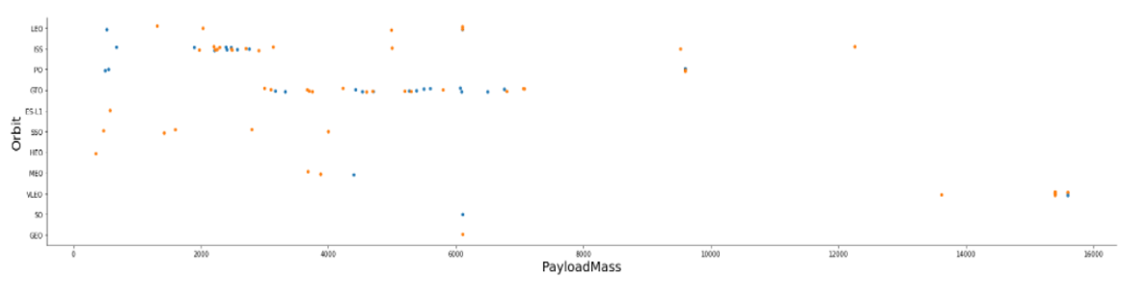
Payload vs. Orbit Type
Show a scatter point of payload vs. orbit type

Slide 23
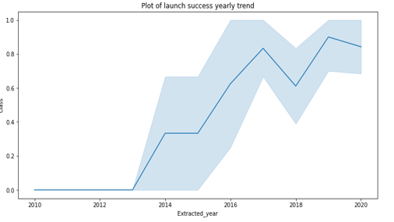
Launch Success Yearly Trend
Show a line chart of yearly average success rate

Slide 24
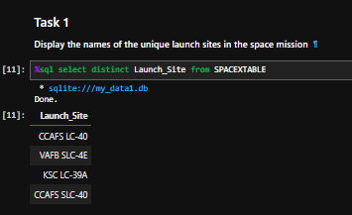
All Launch Site Names
Find the names of the unique launch sites

Slide 25
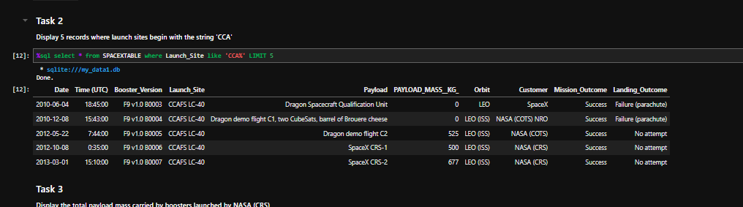
Find 5 records where launch sites begin with `CCA`
Launch Site Names Begin with 'CCA'

Slide 26
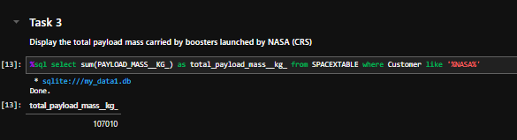
Calculate the total payload carried by boosters from NASA
Total Payload Mass

Slide 27
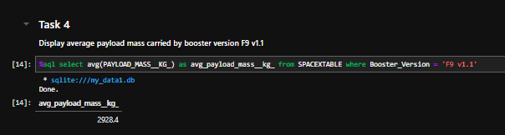
Calculate the average payload mass carried by booster version F9 v1.1
Average Payload Mass by F9 v1.1

Slide 28
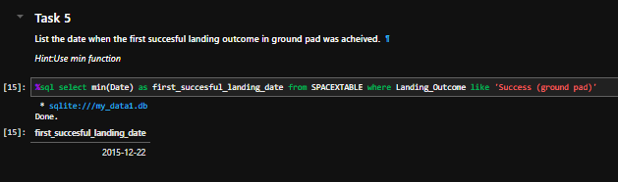
First Successful Ground Landing Date
Find the dates of the first successful landing outcome on ground pad

Slide 29
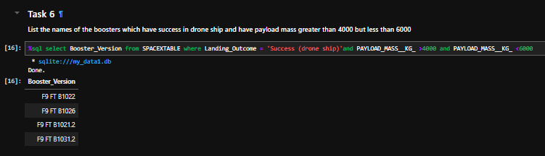
Successful Drone Ship Landing with Payload between 4000 and 6000
List the names of boosters which have successfully landed on drone ship and had payload mass greater than 4000 but less than 6000

Slide 30
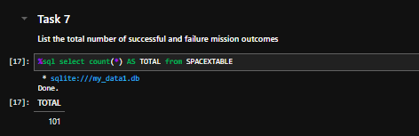
Calculate the total number of successful and failure mission outcomes
Total Number of Successful and Failure Mission Outcomes

Slide 31
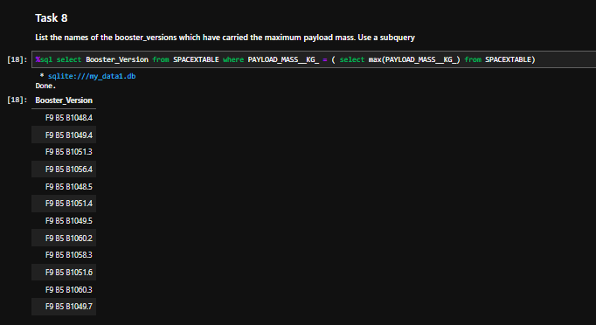
Boosters Carried Maximum Payload
List the names of the booster which have carried the maximum payload mass

Slide 32
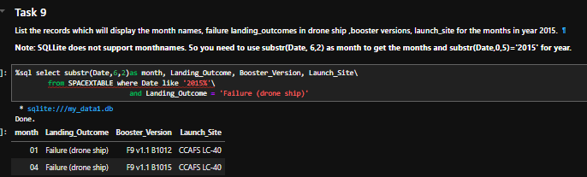
2015 Launch Records
List the failed landing_outcomes in drone ship, their booster versions, and launch site names for in year 2015

Slide 33
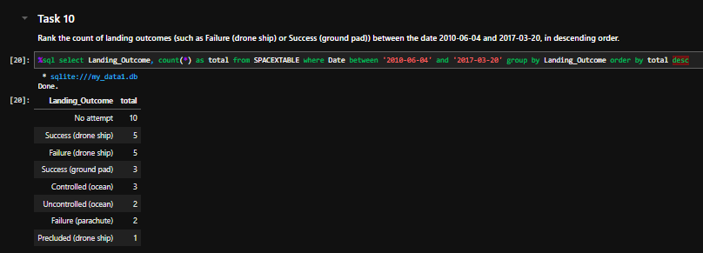
Rank Landing Outcomes Between 2010-06-04 and 2017-03-20
Rank the count of landing outcomes (such as Failure (drone ship) or Success (ground pad)) between the date 2010-06-04 and 2017-03-20, in descending order

Slide 34

Section 3

Slide 35
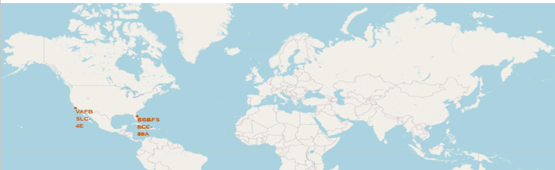
<All launch sites global map markers>

Slide 36
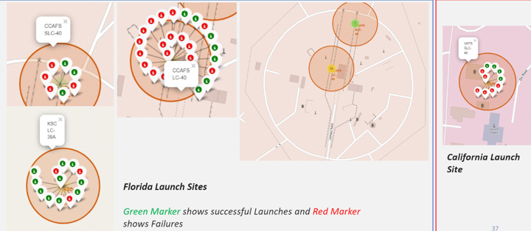
< color-labeled launch outcomes on the map >

Slide 37
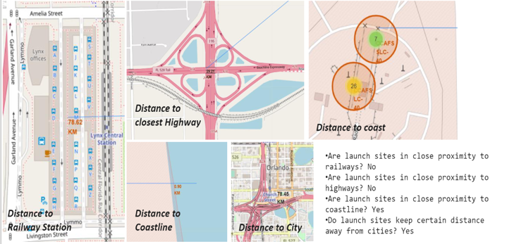
< launch site to its proximities such as railway, highway, coastline, with distance calculated and displayed >

Slide 38

Section 4

Slide 39
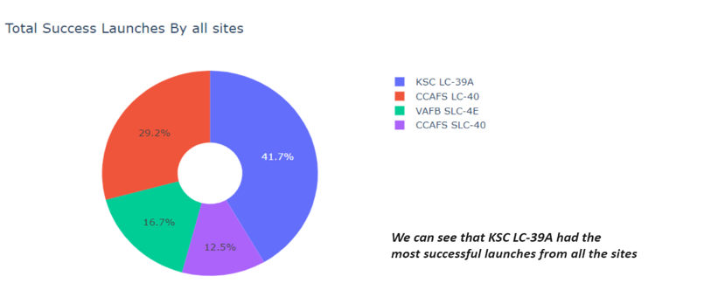
Total Success Launches By All Sites

Slide 40
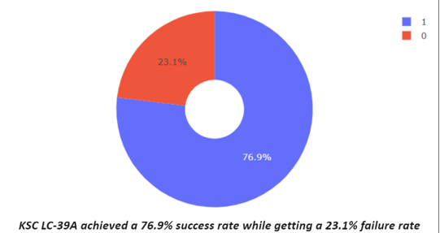
Launch site with the highest launch success ratio

Slide 41
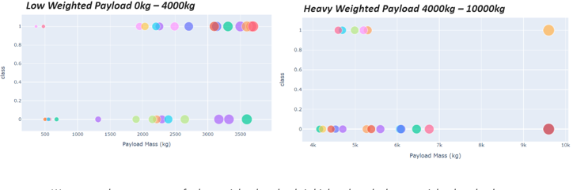
< Payload vs. Launch Outcome scatter plot for all sites >

Slide 42

Section 5

Slide 43
Classification Accuracy

Slide 44

Confusion Matrix
the confusion matrix for the decision tree classifier shows that the classifier can distinguish between the different classes.

Slide 45
Conclusions
Higher flight numbers at a launch site correlate with a greater launch success rate.
The success rate has consistently increased from 2013 to 2020.
Orbits like ES-L1, GEO, HEO, SSO, and VLEO achieved the highest success rates.
KSC LC-39A led in the number of successful launches across all sites.
The Decision Tree Classifier emerged as the best-performing machine learning model for predicting success
By combining factors like payload mass and orbital type with launch site data, we can further refine predictions for Falcon 9's first-stage landing success, potentially optimizing launch site and mission planning for cost efficiency.

Slide 46
Appendix

Slide 47


